Slide 1

Operating Systems Design 19CS2106R​ Session-10 File System Calls: pipe, dup,link and unlink

Slide 2
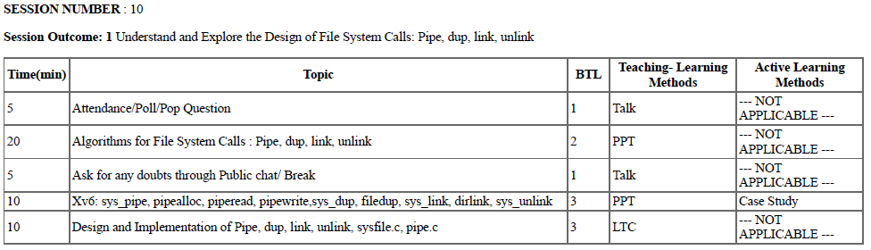
Session Plan

Slide 3
Learning Outcomes
At the end of the session, the student will
Understand the system calls pipe ( ), dup ( ), link ( ) and unlink ( ).
Understand the xv6 case study of the above system calls.
To explore the design and implementation of the above in sysfile.c

Slide 4
Concept of Pipes
Pipes are the IPC mechanism used for communicating between two or more process in Linux i.e to pipe the data between TWO processes.
It is a form of redirection (transfer of standard output to some other destination).
Their implementation allows processes to communicate even though they do not know what processes are on the other end of the pipe.
Two types of pipes:
Unnamed pipes and Named pipes

Slide 5
Pipe is used to combine two or more commands, and in this, the output of one command acts as input to another command, and this command’s output may act as input to the next command and so on.
Piping mechanism is denoted by the ‘|’character.
The command line programs that do the further processing are referred to as filters.

Slide 6
General Syntax:
Command_1 | command_2 | command_3 | .... | command_N
Eg : Listing all files and directories and give it as input to more command.
$ ls -l | more .
Here two commands namely, ls-l and more are piped. ls command lists and more command displays the content one page at a time.

Slide 7
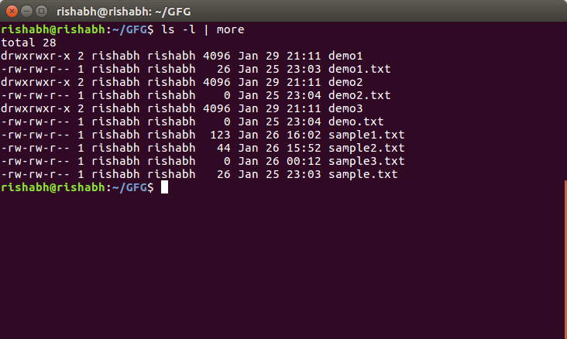
The more command takes the output of $ ls -l as its input. The net effect of this command is that the output of ls -l is displayed one screen at a time. The pipe acts as a container which takes the output of ls -l and gives it to more as input.

Slide 8
Unnamed Pipes
1) These are created by the shell automatically. 2) They exists in the kernel. 3) They can not be accesses by any process, including the process that creates it. 4) They are opened at the time of creation only. 5) They are unidirectional.

Slide 9
Named Pipes( also called FIFO, First In FIrst Out)
They have “names” and exist as special files within a file system.
They are created programmatically using the command mkfifo or using mknod() system call.
They exist until they are removed with rm or unlink() .
Normally used to communicate between TWO totally unrelated processes.
These are bi-directional.

Slide 10
Syntax of pipe ( ) system call
The syntax for creation of a pipe is
pipe (fdptr) ;
where fdptr is the pointer to an integer array that will contain the two file descriptors for reading and writing the pipe.

Slide 11
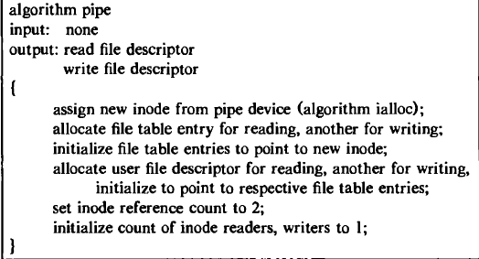
Algorithmic Design Approach of creation of pipe( ) system call-unnamed

Slide 12
dup ( ) System call
The dup system call copies a file descriptor into the first free slot of the user file descriptor table, returning the new file descriptor to the user.
The syntax of the system call is
newfd = dup (fd);
where fd is the file descriptor being duped and newfd is the new file descriptor that references the file.
Because dup duplicates the file descriptor, it increments the count of the corresponding file table entry, which now has one more file descriptor entry that points to it.

Slide 13
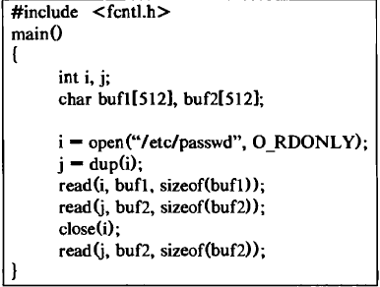
dup ( ) System call-C Procedure

Slide 14
Creating new link to an existing file using link ( ) system call
The link system call links a file to a new name in the file system directory structure, creating a new directory entry for an existing mode.
The syntax for the link system call is
link(source file name, target file name);
where source file name is the name of an existing file and target .file name is the new (additional) name the file will have after completion of the link call

Slide 15
Algorithmic Design for link () system call
Algorithm link
input: existing file name
new file name
output: none
{
get inode for existing file name (algorithm namei);
if (too many links on file or linking directory without super user permission)
{
release inode (algorithm iput);
return (error);
}
increment link count on inode;
update disk copy of inode;
unlock inode;
get parent inode for directory to contain new file name (algorithm namei);
if (new file name already exists or existing file, new file on
different file systems)
{
undo update done above;
return (error); }

Slide 16
Contnd….
Create new directory entry in parent directory of new file name:
include new file name, inode number of existing file name;
Release parent directory inode (algorithm iput);
release inode of existing file (algorithm iput);
}

Slide 17
Removing a directory entry for a file using Unlink ( ) system call
The unlink system call removes a directory entry for a file.
The syntax for the unlink call is
unlink (pathname) ;
where pathname identifies the name of the file to be unlinked from the directory hierarchy.
If a process unlinks a given file, no file is accessible by that name until another directory entry with that name is created.

Slide 18
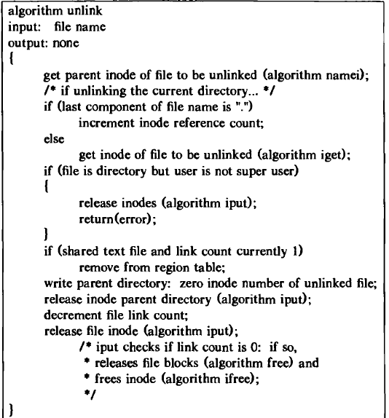
Algorithmic Design of unlink ( )

Slide 19
Xv6 Case Study : sys_pipe, pipealloc, piperead, pipewrite, sys_dup, filedup, sys_link and sys_unlink.

Slide 20
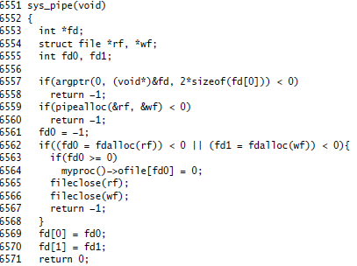
Function of pipe ( ) system call using xv6

Slide 21
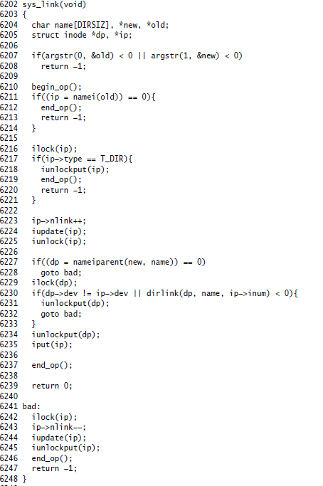
Function of link ( ) using xv6

Slide 22
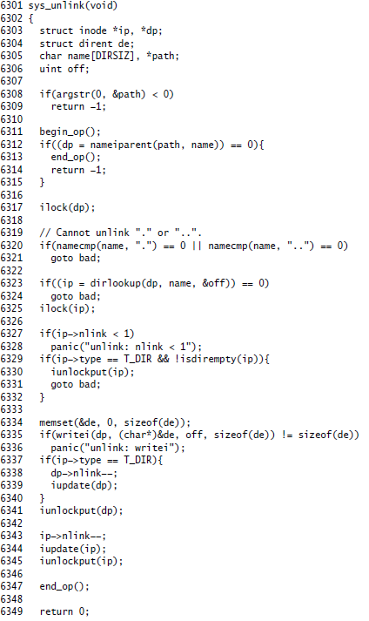
Function of of unlink( ) in xv6

Slide 23


Slide 24
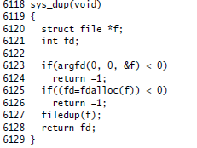
Function of dup ( ) using system call using xv6

Slide 25
Exploring the Design and Implementation of sysfile.c
https://github.com/mit-pdos/xv6-public/blob/master/sysfile.c

Slide 26
sysfile.c is a github repository on various file system calls.
Consists of 444 lines of xv6 code.

Slide 27
sysfile.c file consists of xv6 implementations of
fdalloc( )---for file descriptor allocation
Sys_dup---dup system call
Sys_open—open system call
Sys_read---read system call
Sys_write---write system call
Sys_close---close system call
Sys_fstat----fstat system call
Sys_link----link system call
Sys_unlink---unlink system call
Sys_mknod---mknod system call
Sys_chdir---Chdir System call
Sys_pipe-----Pipe System Call

Slide 28
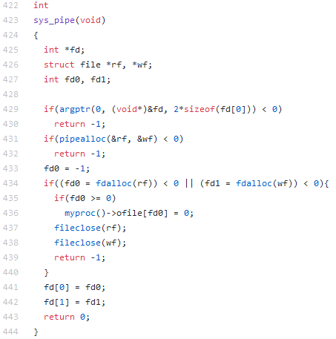
sys-pipe

Slide 29
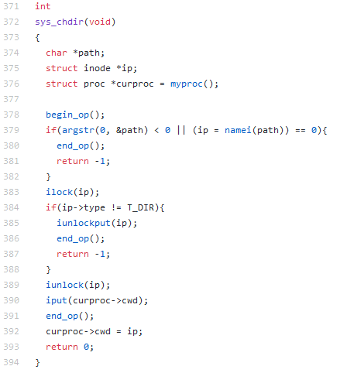
sys_chdir

Slide 30
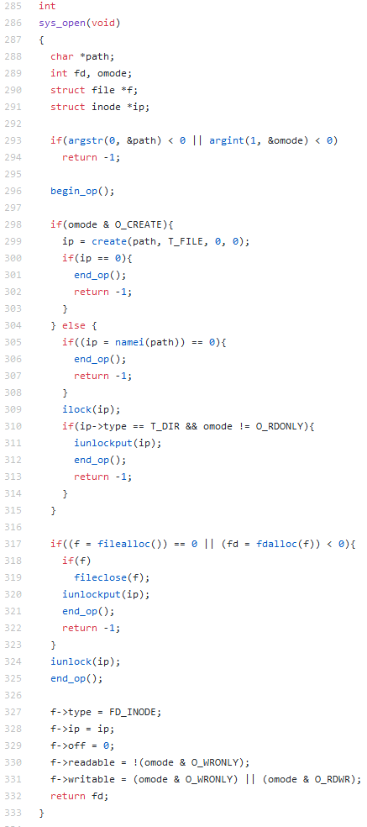
Sys_open

Slide 31
Conduction of ALMs in Breakout Session

Slide 32
ALM-1
Understand the internal algorithms behind the design of various xv6 file system calls.
Perform the given tests related to file system.
Customize the usertests.c given in xv6 source code base and execute.
Submit the output of all the tests

Slide 33
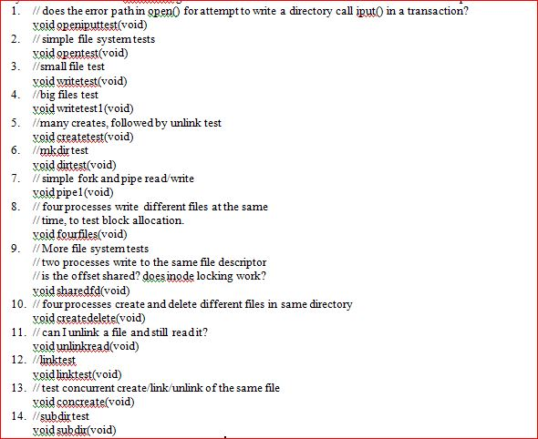
ALM-1

Slide 34
ALM-2
Assume that a process A executes the following three function calls:
fdl = open(“/etc/passwd”, O_RDONLY);
fd2 = open(“local”, O_RDWR);
fd3 = open(“/etc/passwd”, O_WRONLY);
For process A, show the relationship between the inode table, file table, and user file descriptor data structures.
Suppose a second process B executes the following code.
fdl — open("/etc/passwd", 0_RDONLY);
fd2 — open("private", 0_RDONLY);
Draw the resulting picture that shows the relationship between the appropriate data structures while both processes (and no others) have the files open.

Slide 35
ALM-3
The following sequence of code has been observed in various programs:
dup2(fd, 0);
dup2(fd, 1);
dup2(fd, 2);
if (fd > 2)
close(fd);
To see why the if test is needed, assume that fd is 1 and draw a picture of what happens to the three descriptor entries and the corresponding file table entry with each call to dup2. Then assume that fd is 3 and draw the same picture.

Slide 36
ALM-4
Write a program that create two pipes, send filename from command line to child process. In child read that file and send it back using pipe. Parent process should print the file. if error occur in child process error must be send to parent process

